Slide 1


RPA Essential Training Nanyang Polytechnic School of Information Technology

Slide 2

Exception Handling and UI Interactions
What Is Exception?
Resolving a simple business exception
Using Ui Interactions and System Exception handling for email archiving

Slide 3
Exception
An Exception is any error that disturbs the normal flow of instructions while executing a program.
Exception is the amount of deviation in the output shown from the required business.
Some exceptions are:
UI element unfound exception, I/O exception, user exception, class exceptions
There are two main types of exceptions that we face in coding in UiPath studio.
Notes:
The process of identifying error or bug in the running software or Robot is called debugging. It ensures that the error is identified and resolved so that it does not impact the operation and running of the robot. It is a multi-step process that ensures that the program to develop a software or application is perfect. Debugging helps in maintaining the quality and continuity of the code by resolving the errors.
There are multiple types of debugging methods such as interactive debugging, log file analysis, unit testing, control flow analysis, memory dumps, integration testing and profiling.
Validate is one of the key method used in UiPath to identify and resolve the error. This includes identification of the error causing element and then resolving them by following certain steps.
In RPA, there are six steps which are helpful in error handling:
Step Into and Step Over
Validate
Breakpoints
Slow Steps
Options
Logs Section

Slide 4
Exception Handling
Responsive Process
that occurs during run-time
Precautionary method to avoid deviations
Enables
bots to terminate safely
Notes:
The process of identifying error or bug in the running software or Robot is called debugging. It ensures that the error is identified and resolved so that it does not impact the operation and running of the robot. It is a multi-step process that ensures that the program to develop a software or application is perfect. Debugging helps in maintaining the quality and continuity of the code by resolving the errors.
There are multiple types of debugging methods such as interactive debugging, log file analysis, unit testing, control flow analysis, memory dumps, integration testing and profiling.
Validate is one of the key method used in UiPath to identify and resolve the error. This includes identification of the error causing element and then resolving them by following certain steps.
In RPA, there are six steps which are helpful in error handling:
Step Into and Step Over
Validate
Breakpoints
Slow Steps
Options
Logs Section

Slide 5
Types of Exceptions
In UiPath, there are mainly two types of exceptions:
Business Rule Exception
An exception that occurs in the business process is called a business exception.
System Exception
The disruption caused due to a system failure is called a system exception.
Notes:
The process of identifying error or bug in the running software or Robot is called debugging. It ensures that the error is identified and resolved so that it does not impact the operation and running of the robot. It is a multi-step process that ensures that the program to develop a software or application is perfect. Debugging helps in maintaining the quality and continuity of the code by resolving the errors.
There are multiple types of debugging methods such as interactive debugging, log file analysis, unit testing, control flow analysis, memory dumps, integration testing and profiling.
Validate is one of the key method used in UiPath to identify and resolve the error. This includes identification of the error causing element and then resolving them by following certain steps.
In RPA, there are six steps which are helpful in error handling:
Step Into and Step Over
Validate
Breakpoints
Slow Steps
Options
Logs Section

Slide 6
Business Exception
Definition
Example
Solution
Any deviation from the standard business rule in a process or activity is called business exception.
If the subject of an email is not standard and keeps on changing, the Robot will not be able to pick it. This results in a business exception.
To avoid business exception, use a unique identifier.
Notes:
The process of identifying error or bug in the running software or Robot is called debugging. It ensures that the error is identified and resolved so that it does not impact the operation and running of the robot. It is a multi-step process that ensures that the program to develop a software or application is perfect. Debugging helps in maintaining the quality and continuity of the code by resolving the errors.
There are multiple types of debugging methods such as interactive debugging, log file analysis, unit testing, control flow analysis, memory dumps, integration testing and profiling.
Validate is one of the key method used in UiPath to identify and resolve the error. This includes identification of the error causing element and then resolving them by following certain steps.
In RPA, there are six steps which are helpful in error handling:
Step Into and Step Over
Validate
Breakpoints
Slow Steps
Options
Logs Section

Slide 7
System Exception
Definition
Example
Solution
When the normal flow of the automation process is stopped due to the failure of system, it is called system exception.
If the robot is suppose to find a user interface like a button, but the site has changed or relocated and cannot find the element or button. This is categorized as System error.
A System error can be minimized by making the code error proof.
Notes:
The process of identifying error or bug in the running software or Robot is called debugging. It ensures that the error is identified and resolved so that it does not impact the operation and running of the robot. It is a multi-step process that ensures that the program to develop a software or application is perfect. Debugging helps in maintaining the quality and continuity of the code by resolving the errors.
There are multiple types of debugging methods such as interactive debugging, log file analysis, unit testing, control flow analysis, memory dumps, integration testing and profiling.
Validate is one of the key method used in UiPath to identify and resolve the error. This includes identification of the error causing element and then resolving them by following certain steps.
In RPA, there are six steps which are helpful in error handling:
Step Into and Step Over
Validate
Breakpoints
Slow Steps
Options
Logs Section

Slide 8
Try Catch Activity
One of the most reliable methods that we use in UiPath to identify the reason of failure is Try Catch activity.
It is used to enable the program to recover from specific error instead of crashing and terminating the whole workflow.
Try Catch Activity
It can be found in the activities panel. To use Try-Catch activity, we need to drag and drop it inside the workflow.
Notes:
Catching Errors:
This is the remedial method used in UiPath studio to identify the reason of failure and detect the error. One of the most reliable method that we use in UiPath is Try Catch activity. In every automation process, user want to be able to detect the errors as they happen and perform various actions to rectify the errors when they occur.
1. Try-Catch Activity
It is used to recover from specific error instead of crashing and terminating the whole workflow. The Try-Catch activity can be found in the activities panel. To use Try-Catch activity, we will drag and drop it inside the workflow.

Slide 9
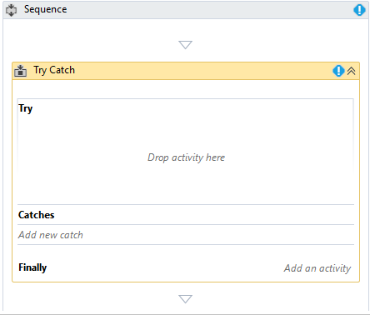
Try Catch Activity (Contd.)
For handling errors in Try Catch block, the workflow is divided into 3 parts:
Try Block
All the possible activities that can create or cause error should be placed in this block.
Catch Block
The user can add multiple type of catches in this block.
Finally Block
It is used for the actions to be performed after the Try & Catch blocks.
Notes:
For handling errors in Try Catch block, the user has to divide the whole workflow into 3 parts:
Try Block: In this, the user has to put all the activities that might throw an error. All the possible activities which you create that cause error that's why it should be placed in the blocks
Catch Block: This is another very important activity to remove the errors. It is actually called “Catches” in UiPath since user can add multiple type of catches.
Finally (Optional one): It is just for the actions to be performed after the try & catch blocks. In case of error or no error still the finally bock will be executed.

Slide 10
Try Catch Activity (Contd.)
Steps of Try Catch Activity are:
Step 1: Drag the Try-Catch activity.
Notes:
Recognizing Error in System Exceptions
Let’s see how its works:
In this sample, we will show if any error occurs in our workflow, it will automatically recognise that error and log a message with circumstances surrounding that exception.
Step 1: Drag the Try-Catch activity.

Slide 11
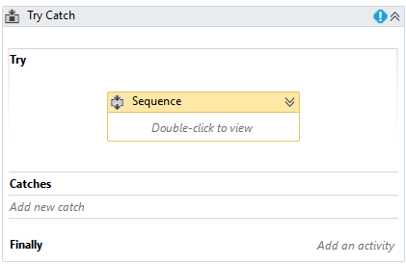
Try Catch Activity (Contd.)
Steps of Try Catch Activity are:
Step 2: Drag a sample sequence or workflow inside it.
Notes:
Recognizing Error in System Exceptions
Step 2: Drag any sample sequence or workflow inside it.

Slide 12
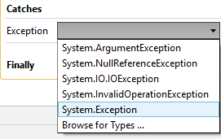
Try Catch Activity (Contd.)
Steps of Try Catch Activity are:
Step 3:
Click on “Catches”
Choose “System. Exception”
Press Enter
Notes:
Recognizing Error in System Exceptions
Step 3: Click on catch and choose “System. Exception” and then press Enter.

Slide 13
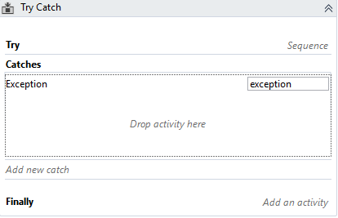
Try Catch Activity (Contd.)
Steps of Try Catch Activity are:
Step 4: The user will get room for the actions in the Catches section.
Step 5: In the Catch block, add activities to take place when an error occurs in the main workflow.
Notes:
Recognizing Error in System Exceptions
Step 4: Now user will get room automatically for the actions in the Catch section.
Step 5: In this Catch block now you can add activities to take place when an error occurs in the main workflow.

Slide 14
Exception Handling
What Is Exception?
Resolving a simple business exception
Using System Exception handling for email archiving

Slide 15
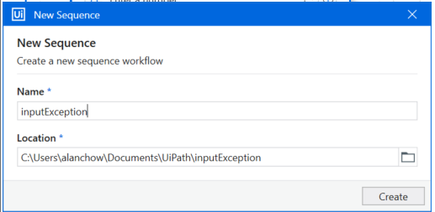

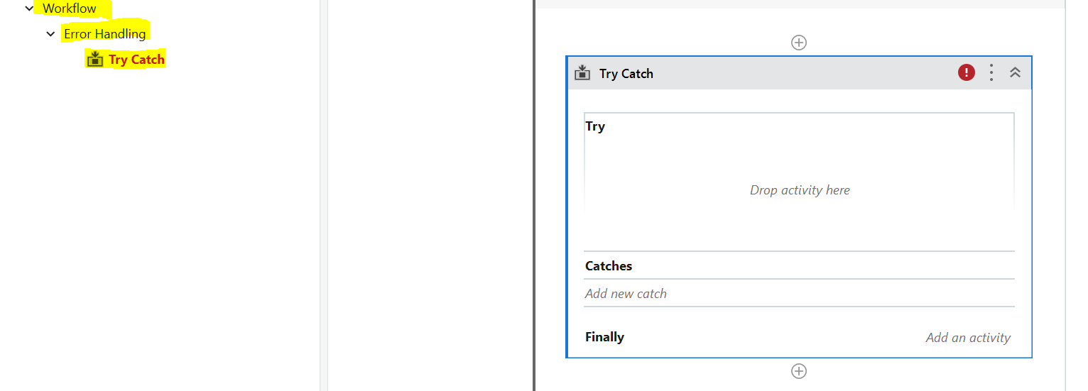
Let’s add a new Sequence in the project-> inputException.xaml
In the activity panel, search for:
Try Catch activity.
Add this to the sequence.

Slide 16
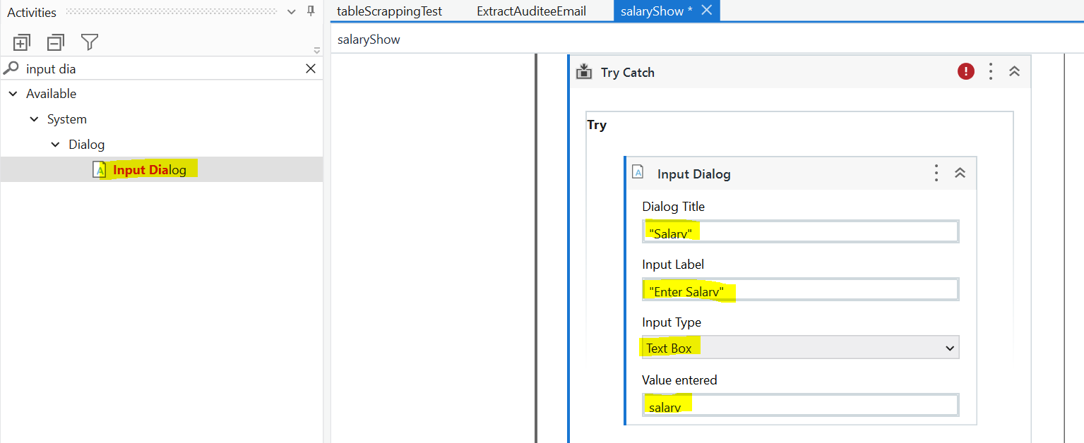
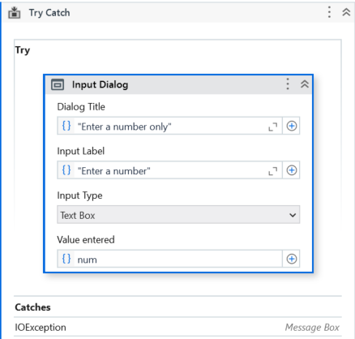
We want the user to enter an integer input dialog.
However, if a user enters a invalid input (example, ABC instead of a number), an business rule exception occurs.
Update the Properties of the Input Dialog:
Title: “Enter a number only”
Label: “Enter a number”
Value entered:
Click on the input box and type “ctrl” + “k” keystroke. Then type the word “num”
In the activity panel, search for:
Input Dialog.
Add this to the TRY sequence.

Slide 17
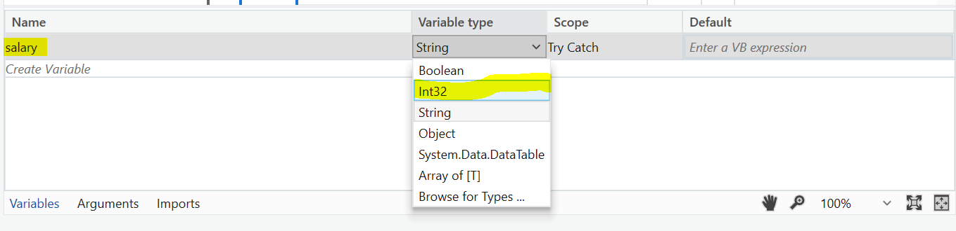
We want to update the variable to a Int32, as salary should be a number, not string.
Go to Variable panel→ num.
Update the Variable type to Int32.

Slide 18
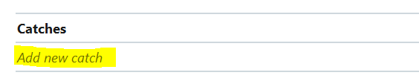
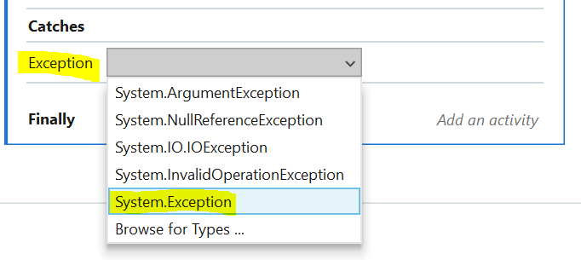
We want to add in the exception handling action if this input dialog throws an error.
Go to Catch activity → Add New Catch.
Select System.Exception.
This means if ANY type of exception occurs, the robot will redirect to this sequence here to handle the exception.

Slide 19
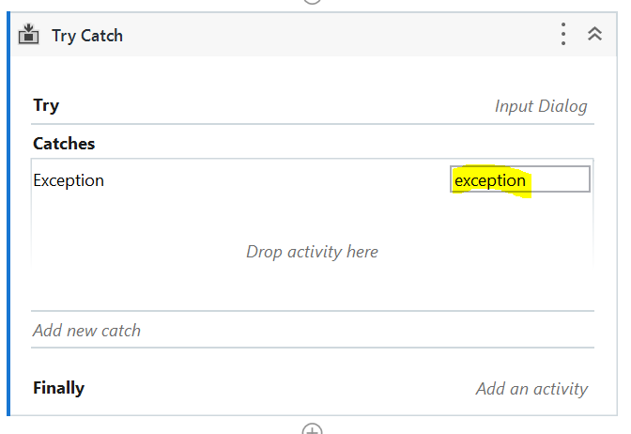
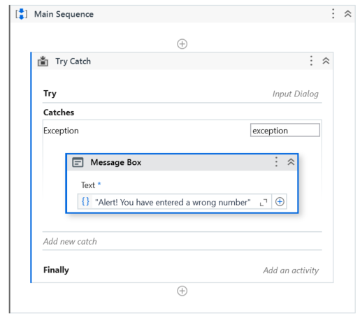
Now, we add in a message box in the catch sequence to warn of exception
Currently the catches sequence is empty.
There are many things you can perform, such as sending email to system admin if an exception occurs. Instead, we will just show a message box for this exercise.
Add in a message box activity in the catch sequence.
Add the exception text:
“Alert! You have entered a wrong number"

Slide 20
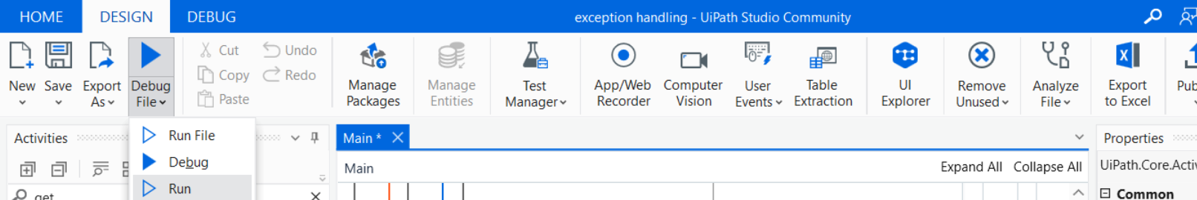
Test your Try catch feature and purposely change the URL to www.nba.com
Click on debug and use run instead of debug. You should see the bot run in full without in stopping halfway.
You should see a pop up

Slide 21
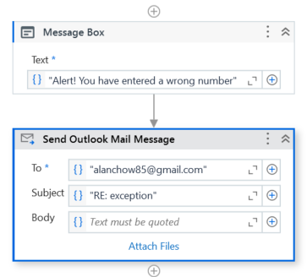
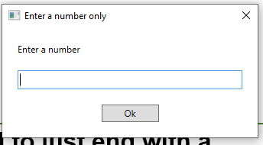
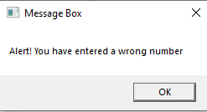
Now, we can run the robot and type ABC to trigger an error.
It does not need to just end with a Message box!
You can even do other types of activities such as sending an outlook email,
or write the error into a log excel file.
Possibilities are endless.

Slide 22
Introduction to UI Interactions
UI interactions are the actions performed by a user to interact with the system at the user interface level.
UI
Input Actions
Output Actions
Notes:
UI elements refer to all graphical user interface pieces that constitute an application (such as windows, checkboxes, text fields, or drop-down lists). UI automation can be easily implemented by using UI interactions which are the actions performed by a user to interact with the system at the user interface level.
There are two types of UI interactions that can appear in automation:
Input Actions
Output Actions

Slide 23
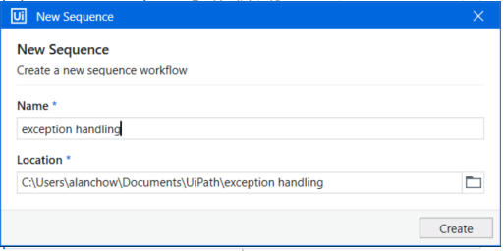
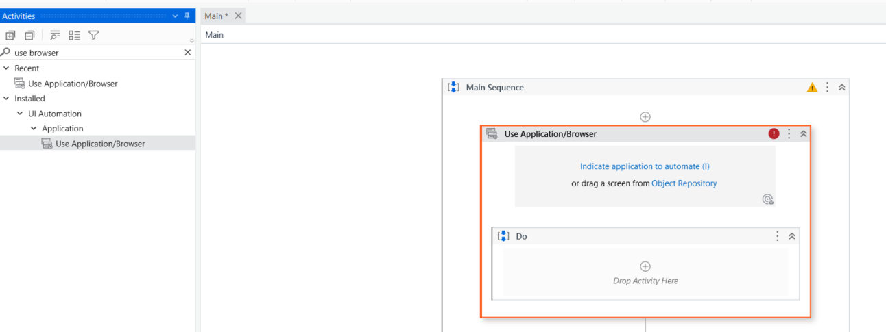
Let’s add a new Sequence in the project-> exception handling.xaml
In the activity panel, search for:
Use application browser

Slide 24
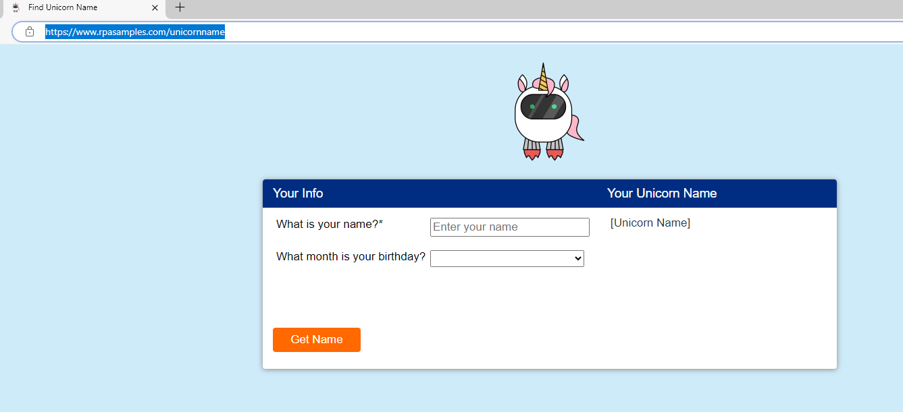

Let’s add a new Sequence in the project-> exception handling.xaml
Go to the website:
https://www.rpasamples.com/unicornname
With Microsoft Edge browser

Slide 25
Let’s add a new Sequence in the project-> exception handling.xaml
Go back to your Uipath studio.
Click on the indicate application to automate and select that browser with ➔https://www.rpasamples.com/unicornname

Slide 26
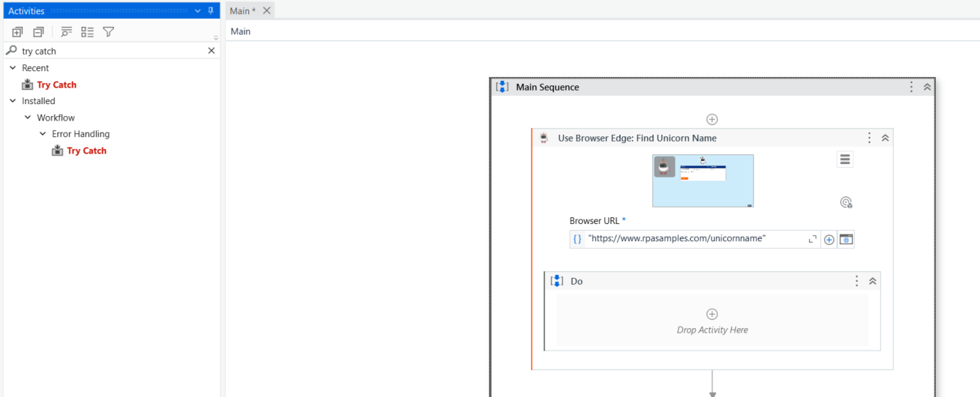
Let’s add a new Sequence in the project-> exception handling.xaml
In the activity panel, search for:
Try Catch activity.
Add this to the Do

Slide 27
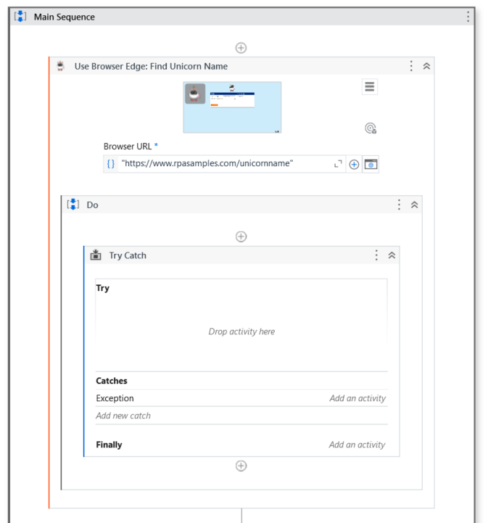
We should see something like the on below

Slide 28
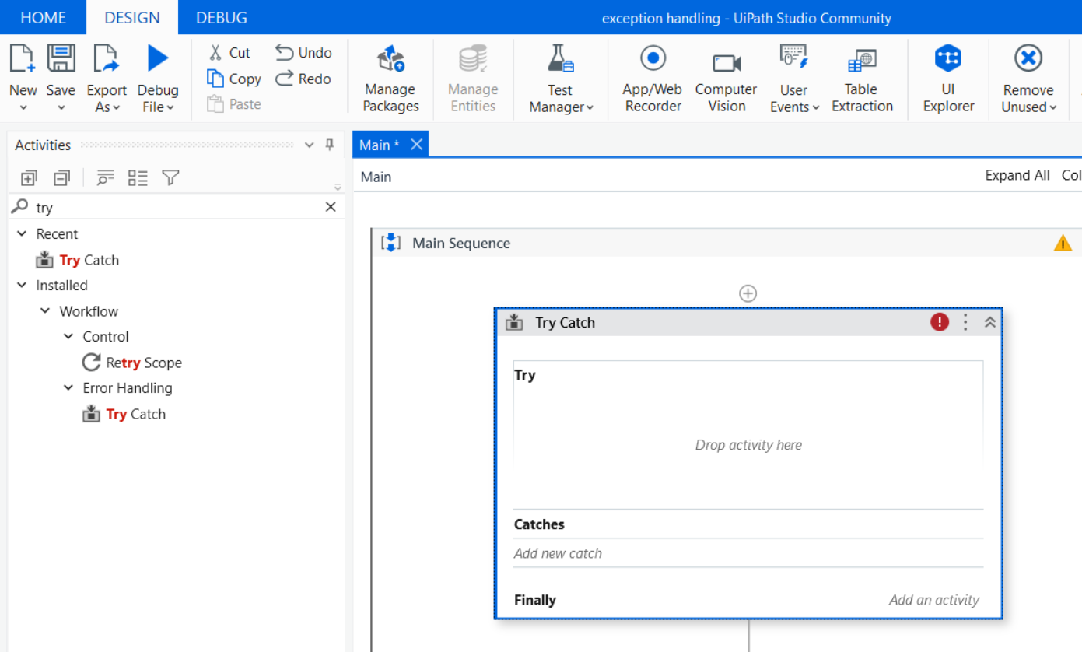
Click on add new catch and select system exception

Slide 29
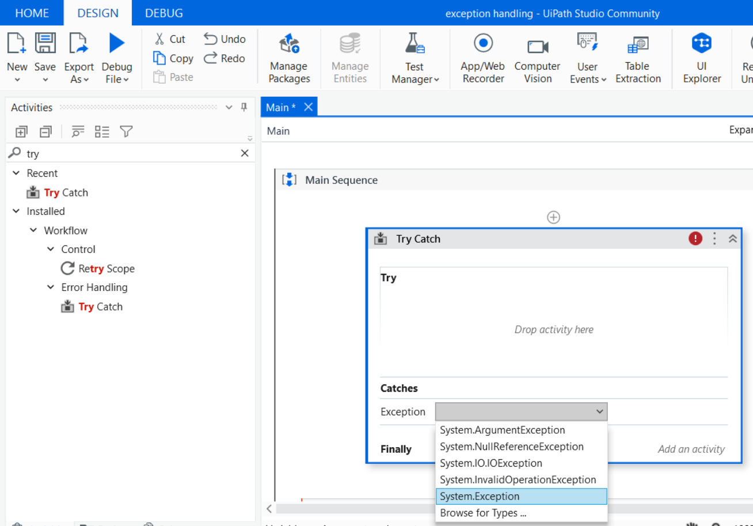

Slide 30
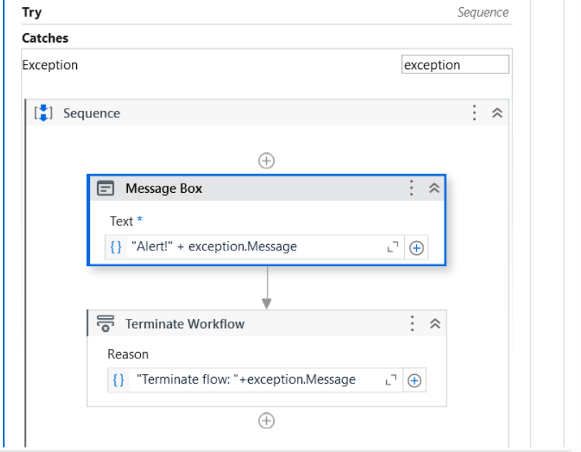
Select message box activity and Terminate workflow activity and put in the exception sequence as shown. Enter the values as shown in the portion in green.

Slide 31
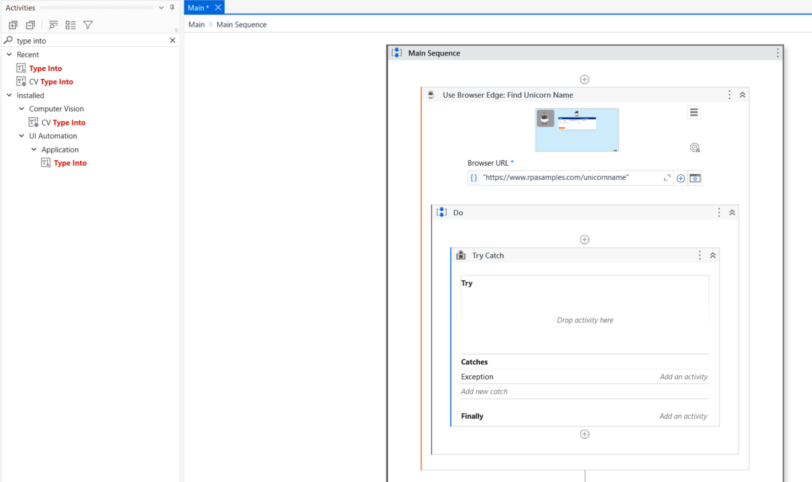
In the activity panel, search for:
Type into and use the one under UI automation

Slide 32
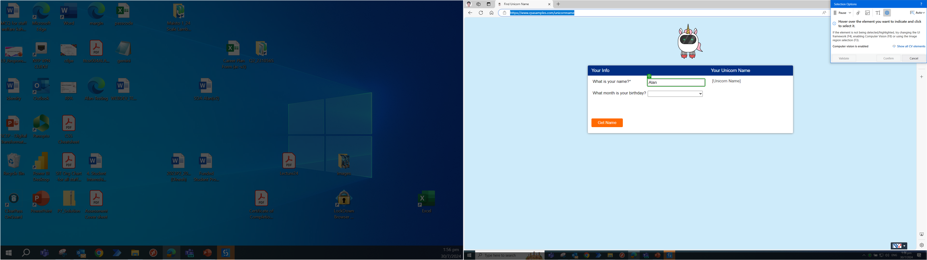
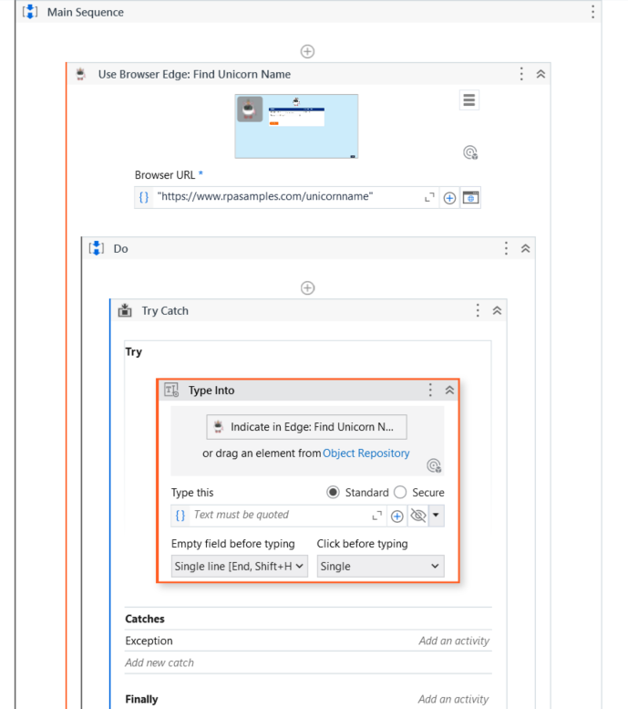
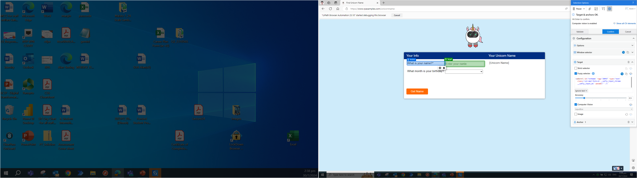
2. select the name input box as the target
3. select the words “what is your name as the archor to ensure the Computer Vision can identify the input box properly”
1 Click on the indicate in edge

Slide 33
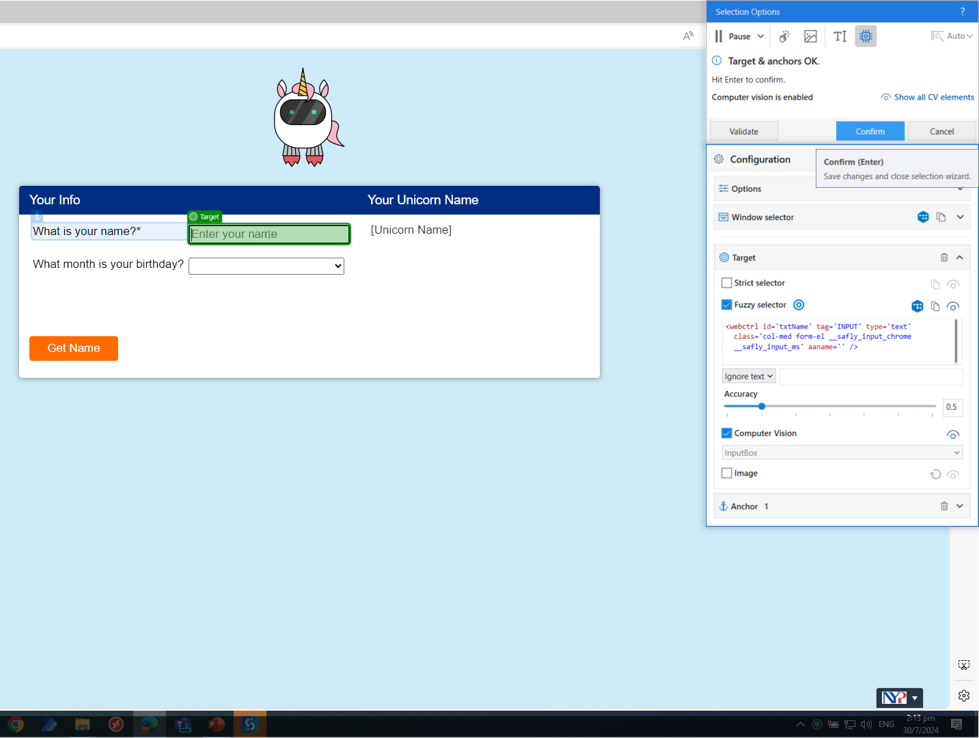
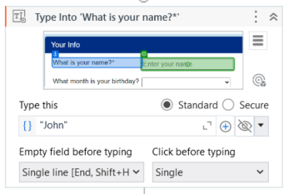
4. Click confirm
5. Type “John” into the field below

Slide 34
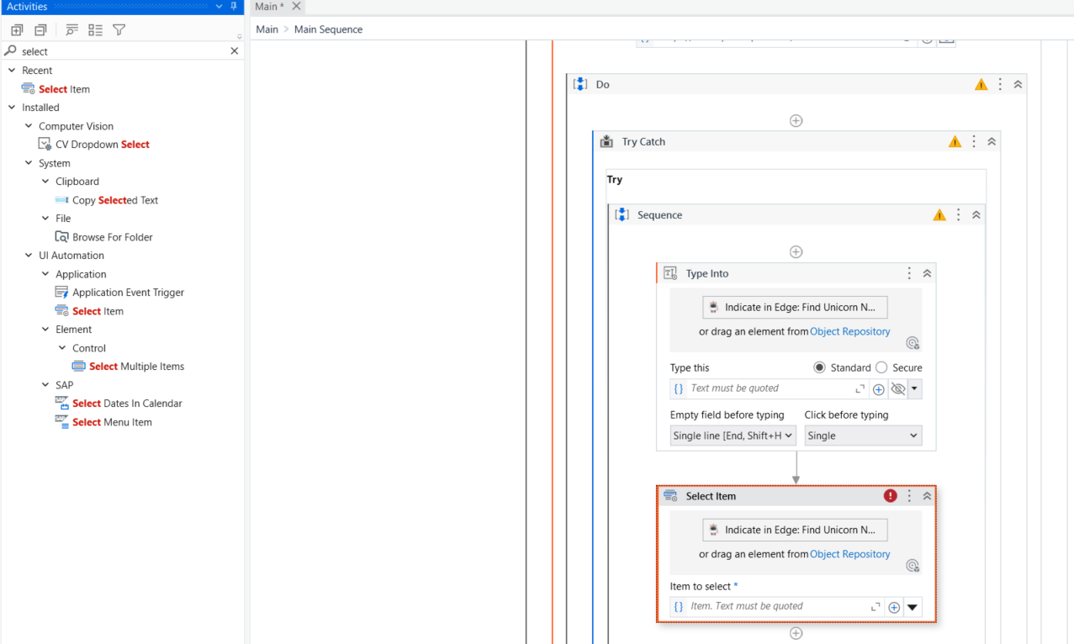
In the activity panel, search for:
Select item and use the one UI automation

Slide 35
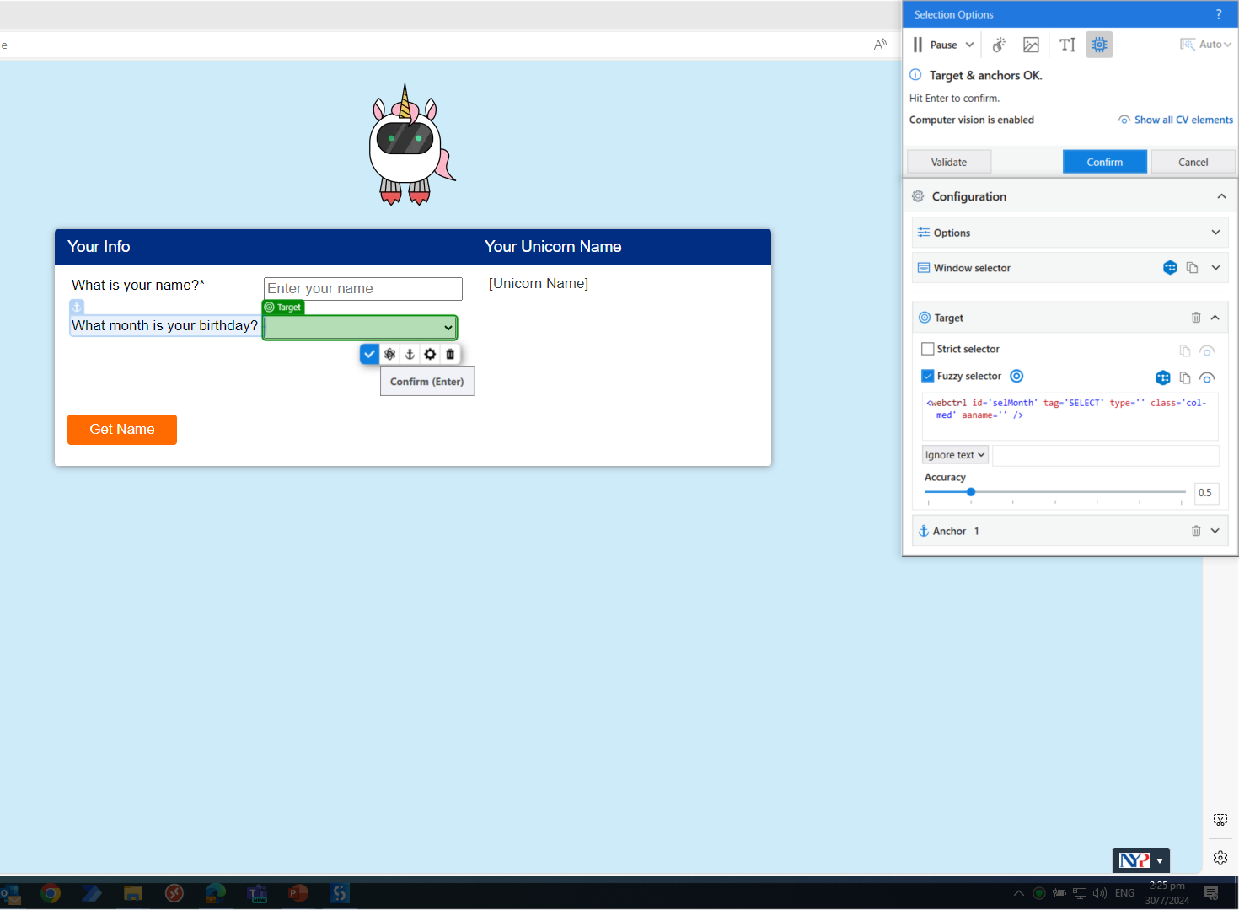

Slide 36
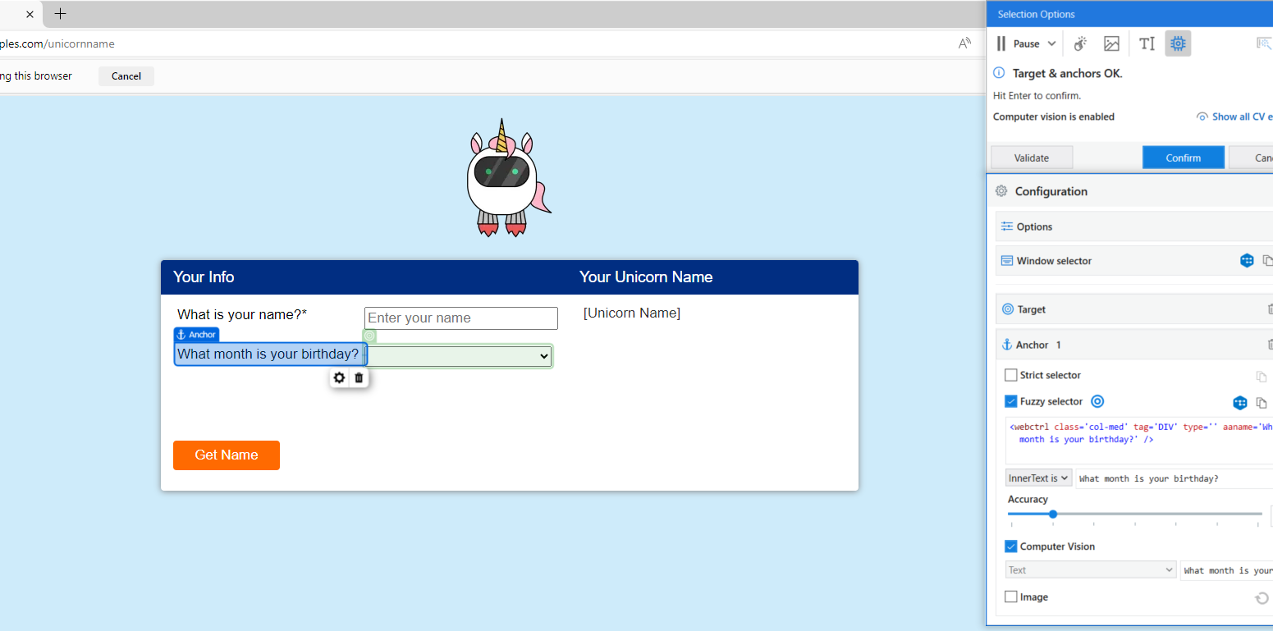
2. select the birthday input box as the target
4. Click confirm
3. select the words “what month is your birthday” as the archor to ensure the Computer Vision can identify the input box properly”

Slide 37
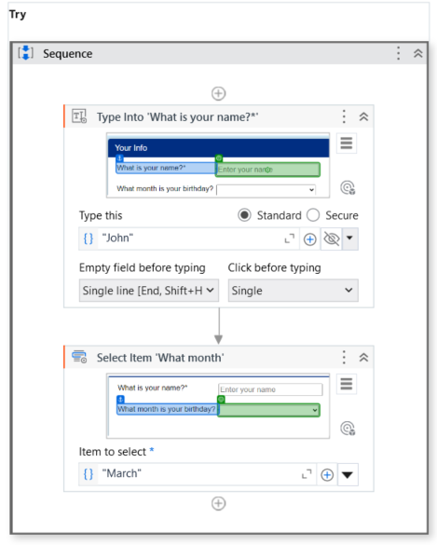
5. Type “March” into the field below

Slide 38
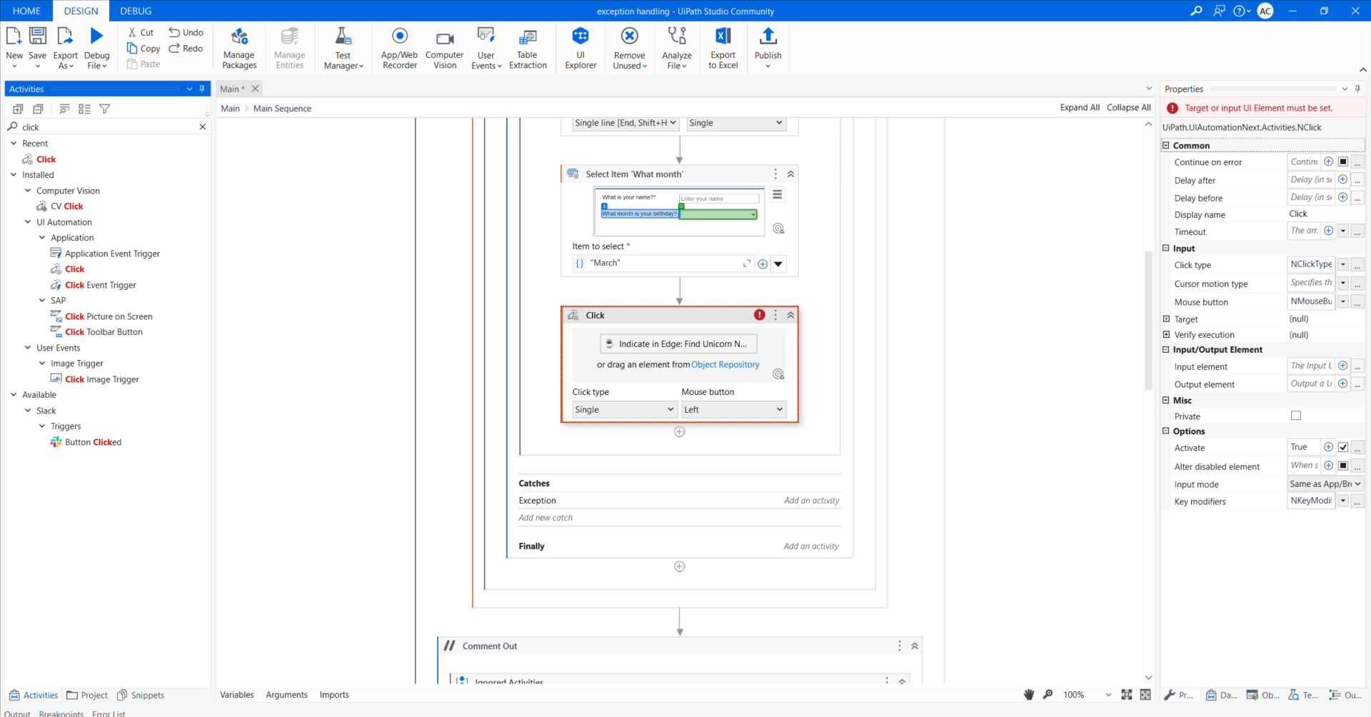

Slide 39
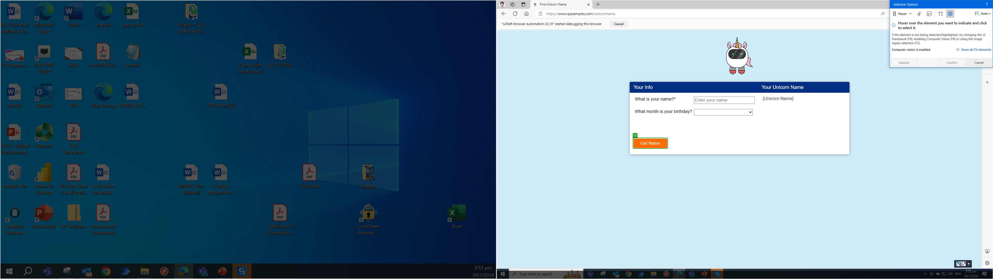
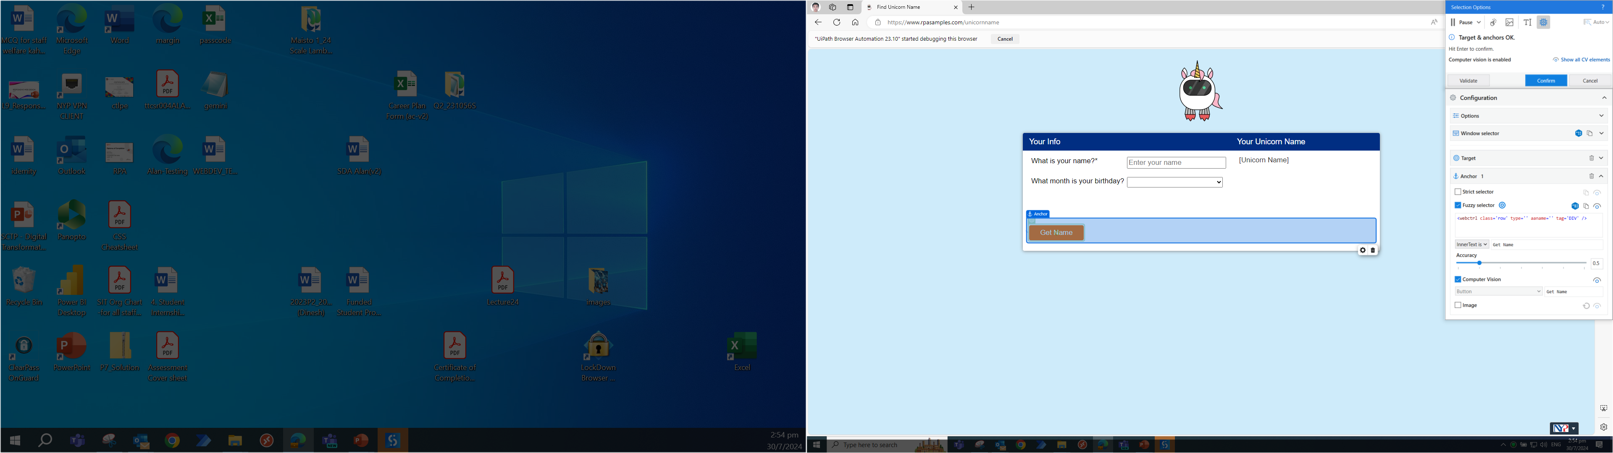
2. select the GetName as target
3. select the outer border as anchor. Then click confirm.

Slide 40
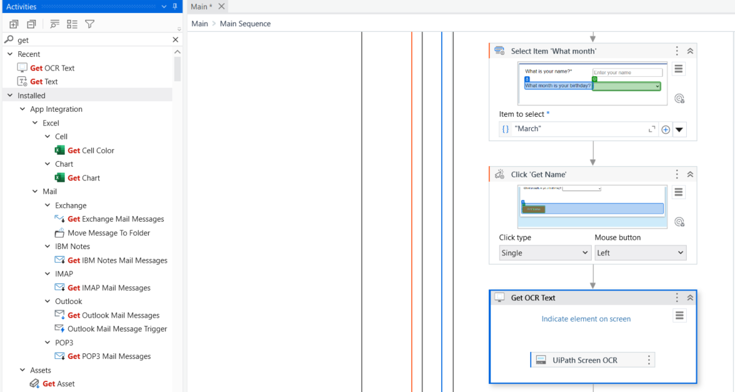
In the activity panel, search for:
Select item and use the get OCR text
Click on indicate element

Slide 41
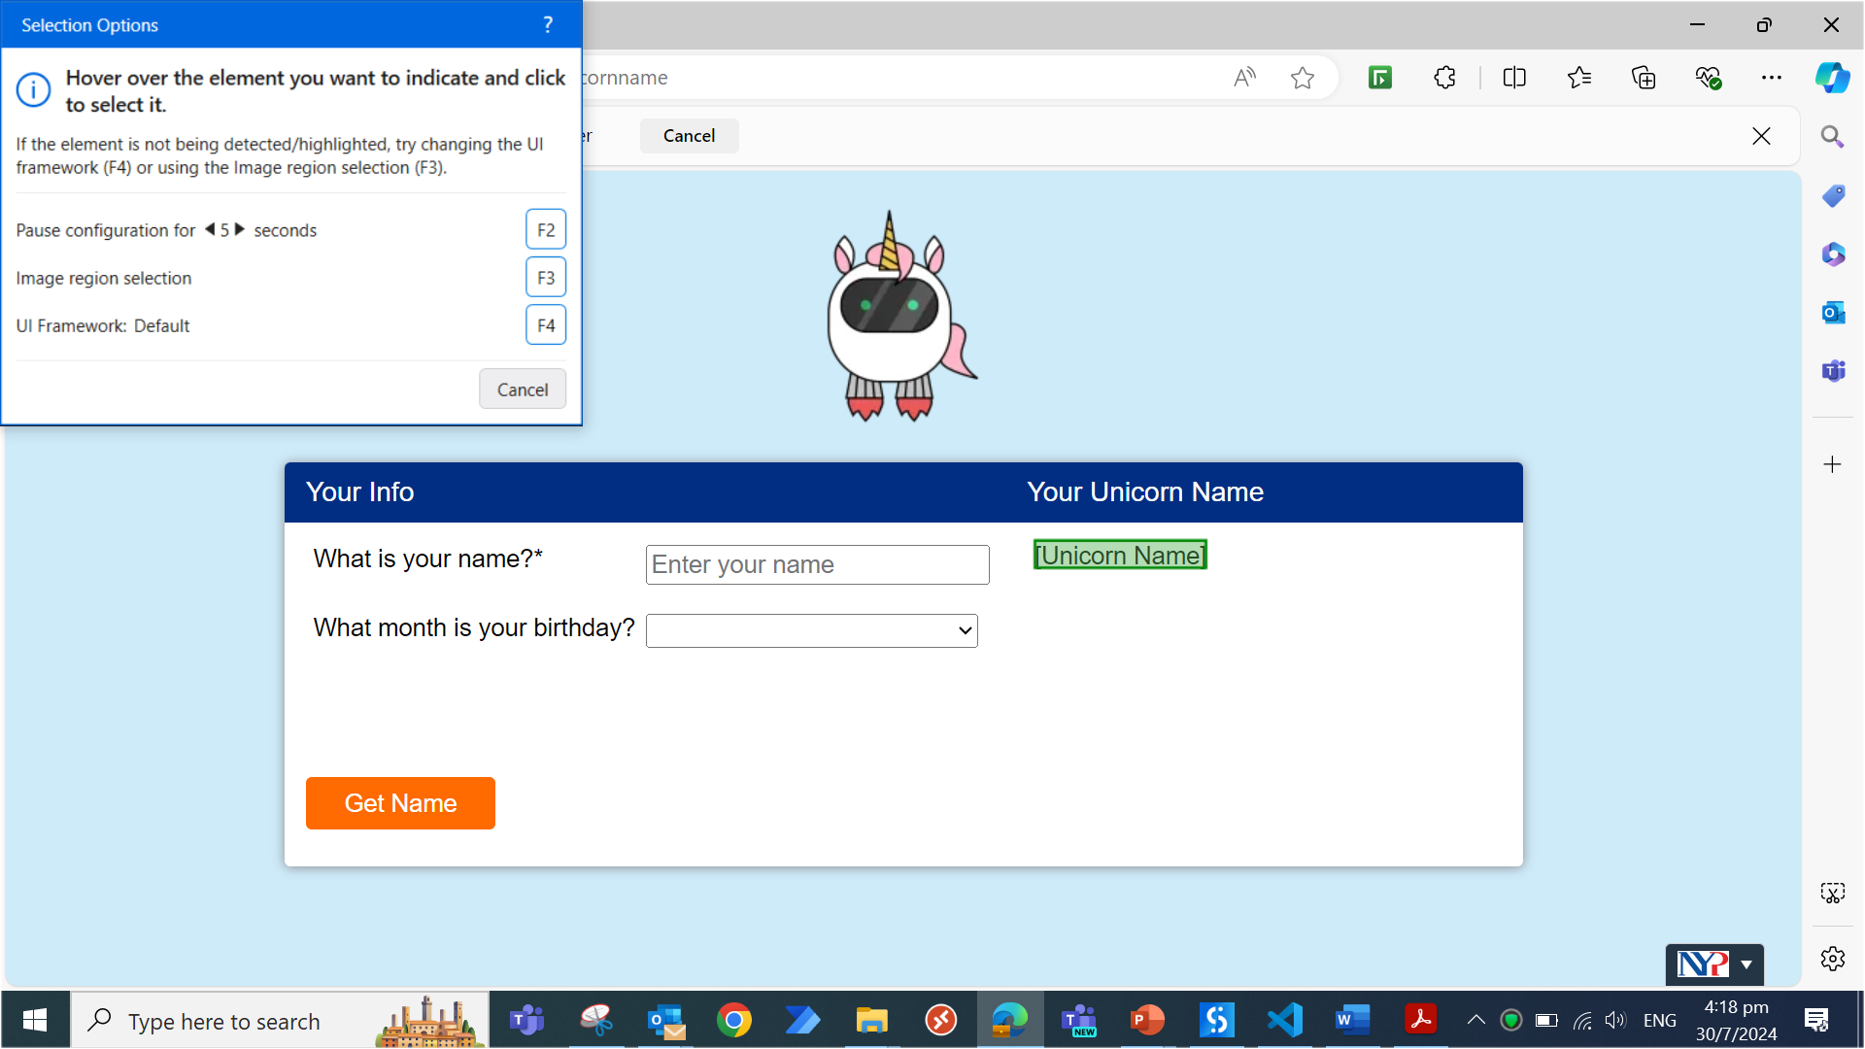
Select the unicorn name as the target

Slide 42
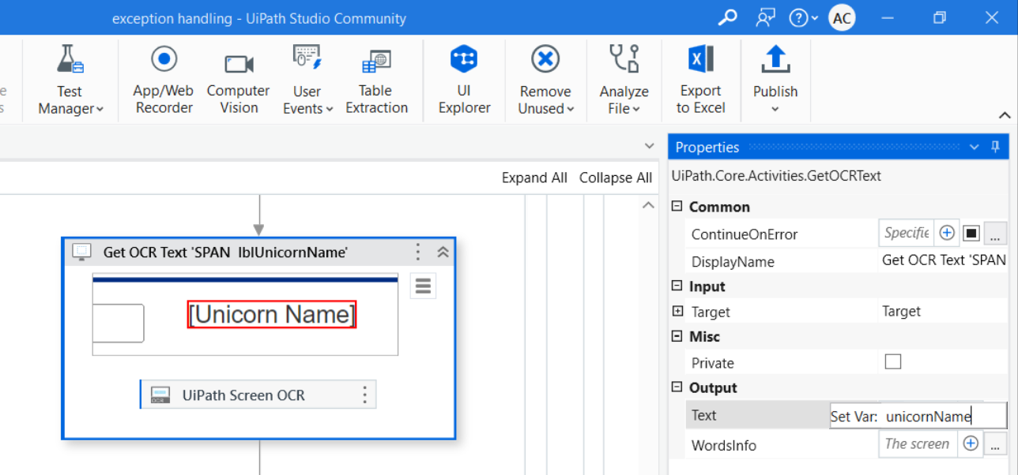
Select the text output and click “ctrl”+ “k”.
Then type the word

Slide 43
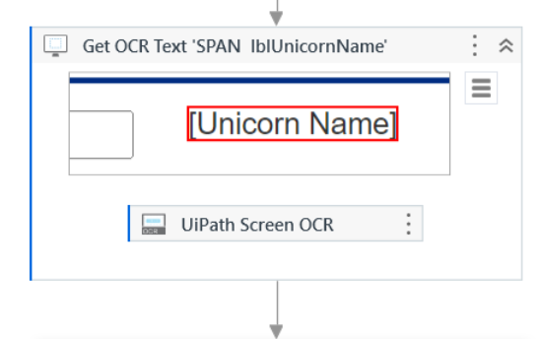
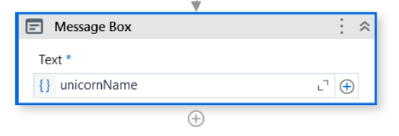
Use a message box and print the unicornName

Slide 44
Click on debug and use run instead of debug. You should see the bot run in full without in debug mode.
You should see the output.

Slide 45
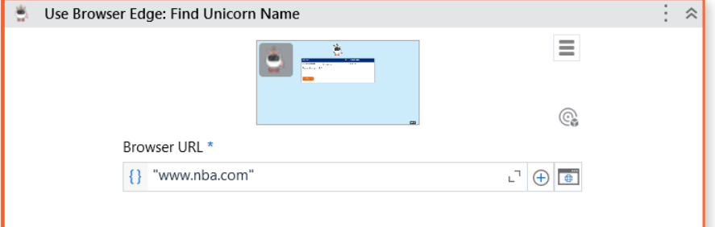
Test your Try catch feature and purposely change the URL to www.nba.com
Click on debug and use run instead of debug. You should see the bot run in full without in stopping halfway.
You should see a pop up

Slide 46
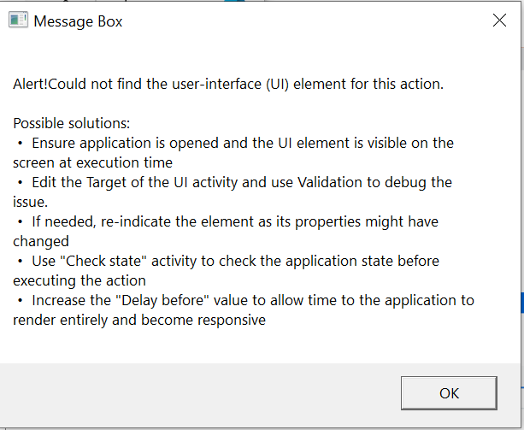
You should see the output of the exception.

